Slide 1


.
Y4 M6c Can identify acute and obtuse angles
Commissioned by The PiXL Club Ltd.
January 2020
This resource is strictly for the use of member schools for as long as they remain members of The PiXL Club. It may not be copied, sold nor transferred to a third party or used by the school after membership ceases. Until such time it may be freely used within the member school.
All opinions and contributions are those of the authors. The contents of this resource are not connected with nor endorsed by any other company, organisation or institution.
PiXL Club Ltd endeavour to trace and contact copyright owners. If there are any inadvertent omissions or errors in the acknowledgements or usage, this is unintended and PiXL will remedy these on written notification.
© Copyright The PiXL Club Limited, 2019

Slide 2
Teachers’ Notes
The PiXL therapies can be taught to a whole class or a target group. Year 3-5 therapies are designed to take approximately 30-40 minutes. However, this is flexible: it may be that only part of the therapy is taught or it could, of course, be adapted or extended.
Each therapy begins with a LORIC activity to develop relevant learning behaviours.
This is followed by a vocabulary task, which uses the PiXL 5-phase approach to teach key mathematical vocabulary. Further resources to develop vocabulary can be found in the Whole School area.
Each therapy adopts the ‘Teach, model and apply’ process with opportunities for pupils to demonstrate the taught skill independently.
Problem solving and reasoning activities are an integral part of each therapy.

Slide 3
Progress across amber – the 4-stage model
The three therapy tests which accompany this resource can be used to revisit the taught skill to check that the pupil is able to perform it independently and consistently.
A
A child has successfully completed a therapy test independently, following a set of therapy sessions.
A child has successfully completed a therapy test independently, a period after the relevant therapy sessions – we would advise about 2 weeks.
A child has successfully applied their knowledge or skill in an unfamiliar context. This may be application across the curriculum or in a problem.
A pupil has successfully re-visited the skills at a later point, and applies these in an unfamiliar context or problem, or across the curriculum.
A
DA
G

Slide 4

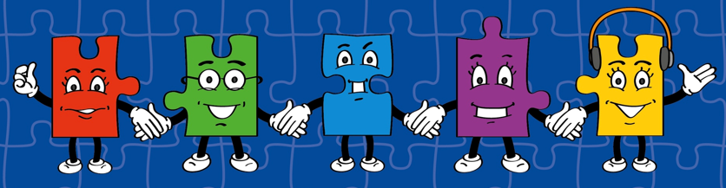
LORIC task
The LORIC task will focus on your Raj Resilience skills today:
Do not be put off by a difficult task.
Keep going – persevere.
Think about ways you can help yourself and others.

Slide 5

LORIC task
How many different possibilities can you find?
x
=
84

Slide 6
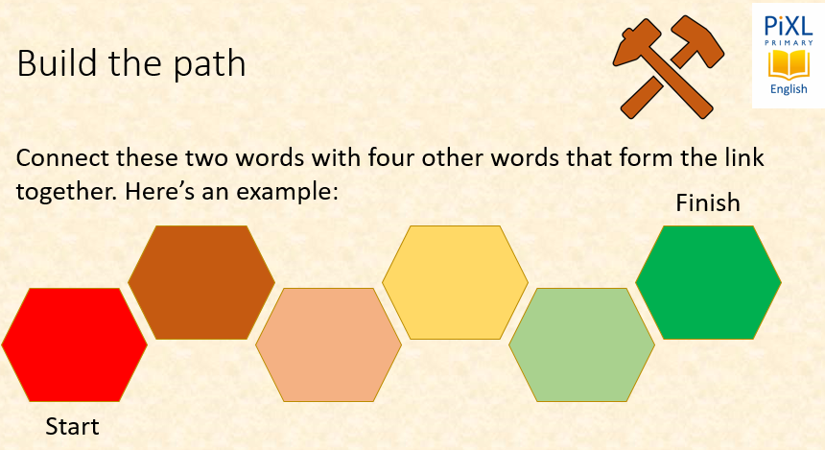
Vocabulary activity
identify
compare
LINK IT
Notes:
In this activity, pupils will be asked to reason about vocabulary. Teachers may wish to award points or rewards for ambitious choices or excellent explanations. Pupils should be encouraged to think creatively about how to ‘build the path’ between the two words. Perhaps this could be through spelling patterns, word meaning or association, words with the same roots or another pattern that they outline themselves.

Slide 7
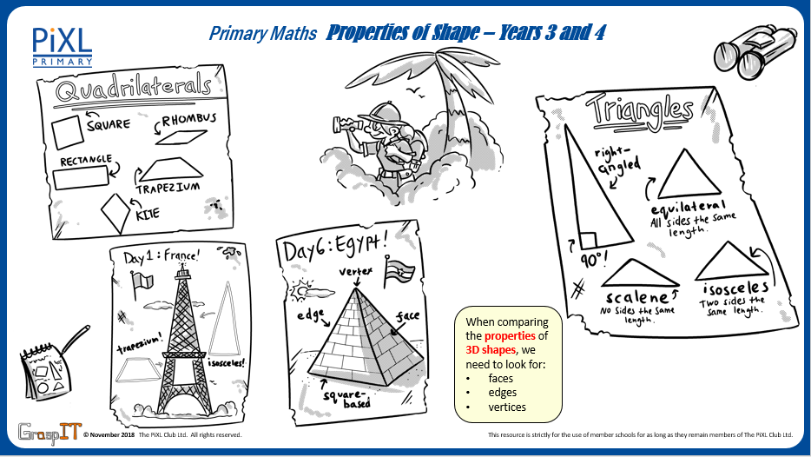
Notes:
Knowledge Mats can be helpful to support learning.

Slide 8
Teach
One way of classifying 2-D shapes is by identifying the angles in a shape.
An angle that is less than a right angle will be less than 90⁰ (degrees).
A right angle is an angle of exactly 90⁰ (degrees).
An angle that is greater than a right angle will be more than 90⁰ (degrees).

Slide 9
Teach
One way of classifying 2-D shapes is by identifying the angles in a shape.
This is called an acute angle.
This is called a right angle.
This is called an obtuse angle.

Slide 10
Model
A right angle is an angle of exactly 90⁰ (degrees).
I know a right angle is 90⁰ and I can see that this angle is less than a right angle because the line goes through the square.
This means this angle is an acute angle.

Slide 11
Model
A right angle is an angle of exactly 90⁰ (degrees).
I know a right angle is 90⁰ and I can see this is greater than a right angle because I can see the line beyond the square.
This angle is an obtuse angle.

Slide 12
Model
A right angle is an angle of exactly 90⁰ (degrees).
This pentagon has 3 right angles as there are 3 vertices with 90⁰ angles.
There are two vertices where the angle is larger than 90⁰ (these are marked in red). These are obtuse angles.

Slide 13
Model
This quadrilateral has no right angles
(90⁰ angles).
There are two vertices where the angle is greater than 90⁰ (these are marked in red). These are obtuse angles.
There are two vertices where the angle is less than 90⁰ (these are marked in green).
These are acute angles.

Slide 14
Apply
Tick the angles which show an acute angle.

Slide 15
Apply
Draw another line onto each given line to create an obtuse angle.

Slide 16
Apply
Draw another line onto each given line to create an acute angle.

Slide 17
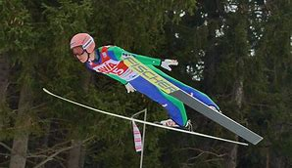
Apply – Problem Solving
Nancy loves going ski jumping. She normally jumps at an acute angle. She jumps three times and jumps higher each time. Draw an acute angle for each jump.
Jump One
Jump Two
Jump Three

Slide 18
Apply – Problem Solving
Nancy loves going ski jumping. She normally jumps at an acute angle. She jumps three times and jumps higher each time. Complete her acute angle for each jump.
One example could be:
Jump One
Jump Two
Jump Three

Slide 19
Apply – Reasoning
Emily draws this 2-D shape. She says IT has at least one of each of the following angles:
A right angle
An acute angle
An obtuse angle
Is she correct? Explain how you know. Label the angles to support your answer.

