Slide 1


.
M1g: Can solve problems using place value and number facts
Commissioned by The PiXL Club Ltd.
June 2019
This resource is strictly for the use of member schools for as long as they remain members of The PiXL Club. It may not be copied, sold nor transferred to a third party or used by the school after membership ceases. Until such time it may be freely used within the member school.
All opinions and contributions are those of the authors. The contents of this resource are not connected with nor endorsed by any other company, organisation or institution.
PiXL Club Ltd endeavour to trace and contact copyright owners. If there are any inadvertent omissions or errors in the acknowledgements or usage, this is unintended and PiXL will remedy these on written notification.
© Copyright The PiXL Club Limited, 2019

Slide 2
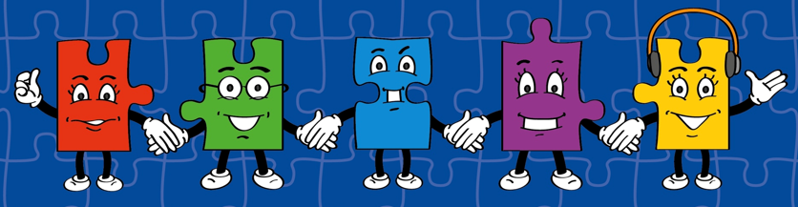
Our Primary Edge attributes help us to become better learners and today is no exception. Before you start this activity, here are some ideas for how you will need your Raj Resilience skills today:
LORIC Task
Command Words:
Persevere Complete
Overcome Achieve Sustain Undertake
Learn over time
Trying hard even when it is challenging
Learning from your mistakes
Asking for help if you need it

Slide 3

LORIC Task
Which number is the odd one out?
Explain your answer.
30
6
18
36
24
42
12
8
Notes:
8 is the odd one out. The rest are all multiples of 6.

Slide 4
Vocabulary
The word is: | Meaning: _________________ _________________ _________________ _________________ _________________
Image/graphic: | In context: _________________ _________________ _________________ _________________ _________________
Key word:
Place value

Slide 5
Can solve problems using place value and number facts
Let’s have a look at these two examples and talk about which is correct and why.
H | T | O
3 | 5 | 9
What has this person done incorrectly?
This number is 359.
H | T | O
8 | 6
Show me on your whiteboards how 86 should look.
This number is 86.

Slide 6


Can solve problems using place value and number facts
Let’s look at what would happen if that person tried to add those two numbers together.
Th | H | T | O
 | 3 | 5 | 9
+ | 8 | 6
1 | 2 1 | 1 | 9
Th | H | T | O
 | 3 | 5 | 9
+ |  | 8 | 6
 | 4 1 | 4 1 | 5

Slide 7
Can solve problems using place value and number facts
This is why place value is so important. Such a simple mistake can mean your answer is incorrect even if your addition is correct!
Th | H | T | O
 | 3 | 5 | 9
+ | 8 | 6
1 | 2 1 | 1 | 9

Slide 8
Can solve problems using place value and number facts
This is why place value is so important. Such a simple mistake can mean your answer is incorrect even if your addition is correct!
Th | H | T | O
 | 3 | 5 | 9
+ | 8 | 6
1 | 2 1 | 1 | 9

Slide 9

Can solve problems using place value and number facts
I’m thinking of a 3-digit number. The hundreds digit is double the tens digit. What could my number be?
How might we go about solving this? Tell the person next to you.

Slide 10
Can solve problems using place value and number facts
I’m thinking of a 3-digit number. The hundreds digit is double the tens digit. What could my number be?
What do we know?
We know that:
There are three digits in the number.
The hundreds digit is double the tens digit.
The ones digit is not mentioned, so we could use any digit from 0-9.

Slide 11
Can solve problems using place value and number facts
I’m thinking of a 3-digit number. The hundreds digit is double the tens digit. What could my number be?
If we start by making the tens digit a 1, we can work from there.
If the tens digit is a 1, then we know that the hundreds digit must be a 2 because 2 is double 1.
I could place a zero in the ones column. So, one possibility is
210

Slide 12
Your turn
I’m thinking of a 3-digit number. The hundreds digit is double the tens digit. What could my number be?
210
What other possibilities could there be?
Show me on your white board.

Slide 13
Can solve problems using place value and number facts
I want to make a number between 200 and 500 and I have three digits: 6, 2 and 7.
H | T | O
Have I made a number between 200 and 500?
Why not?
6
2
7

Slide 14
Can solve problems using place value and number facts
I want to make a number between 200 and 500 and I have three digit: 6, 2 and 7.
H | T | O
Let’s try again…
Have I made a number between 200 and 500?
7
6
2

Slide 15
Can solve problems using place value and number facts
I want to make a number between 200 and 500 and I have three digits: 6, 2 and 7.
One more time…
What place value do I need to give these numbers in order to make a number between 200 and 500?
H | T | O
2
6
7

Slide 16
Can solve problems using place value and number facts
I want to make a number between 200 and 500 and I have three digits: 6, 2 and 7.
Or…
H | T | O
2
7
6

Slide 17
Your turn
I want to make a number between 500 and 800.
I have the digits 9, 6 and 5. What numbers can I make?
H | T | O

Slide 18
Your turn
I want to make a number between 300 and 900.
I have the digits 7, 2 and 8. What numbers can I make?
H | T | O

Slide 19
Can solve problems using place value and number facts
Number facts are simply multiplication, division, addition and subtraction calculations that you should know without having to work them out.
Knowing these well can help you solve mathematical problems quickly!

Slide 20
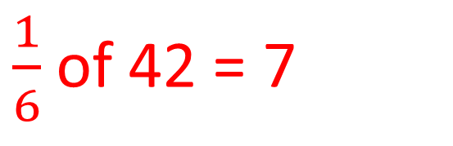
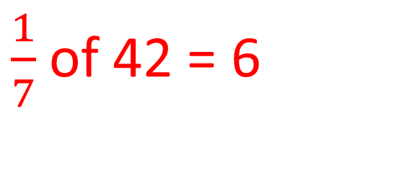
Can solve problems using place value and number facts
If we know that 6 x 7 = 42, what else do we know?
6 x 7 = 42
7 x 6 = 42
What do you notice about these numbers?
42 ÷ 6 = 7
42 ÷ 7 = 6
$\frac{1}{6}$of 42 = 7
$\frac{1}{7}$of 42 = 6

Slide 21
Can solve problems using place value and number facts
To make a set of number facts, we need to look at the relationship between the numbers.
Division and multiplication are inverse operations, so by swapping the numbers, we can create different number statements.
Remember that finding a fraction of a number is the same as division.
6 x 7 = 42
7 x 6 = 42
42 ÷ 6 = 7
42 ÷ 7 = 6
$\frac{1}{6}$of 42 = 7
$\frac{1}{7}$of 42 = 6

Slide 22
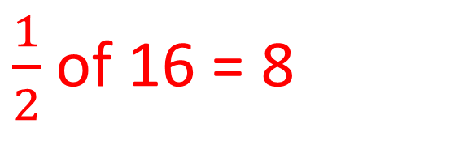
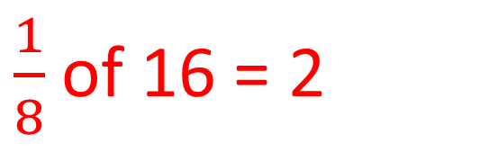
Can solve problems using place value and number facts
Let’s look at these three numbers and use them to make a set of multiplication, division and fraction facts.
2 x 8 = 16
8 x 2 = 16
8, 16, 2
16 ÷ 2 = 8
16 ÷ 8 = 2
$\frac{1}{2}$of 16 = 8
$\frac{1}{8}$of 16 = 2

Slide 23
Your turn
Write down a set of multiplication, division and fraction facts for these numbers.
15, 3, 5

Slide 24
How can number facts help us to solve a problem?
Let’s look at how knowing those number facts can help you with reasoning and problem solving.
The perimeter of an equilateral triangle is 15 centimetres. What is the length of one side of the triangle?
How could we use our number facts to help us solve this problem?

Slide 25
How can number facts help us to solve a problem?
The perimeter is the continuous line that forms the boundary of a 2D shape.
What do we know?
We know that:
The shape is an equilateral triangle so it must have 3 equal sides.
The total of the sides is 15cm.

Slide 26
How can number facts help us to solve a problem?
What do we know?
We know that:
The shape is an equilateral triangle so it must have 3 equal sides.
The total of the sides is 15cm.
To enable use to find out what each of the sides would equal, we would need to divide 15 by 3.

Slide 27
How can number facts help us to solve a problem?
We can use what we know about the relationship between 15 and 3 to help us. Using our knowledge of multiples of 5, we can work out that 3 x 5 = 15.
If 3 x 5 = 15 then 15 ÷ 3 = 5
That helps us work out that each of the sides of the triangle must equal 5cm.
5cm
5cm
5cm

Slide 28
Your turn
The perimeter of a square is 32cm. What is the length of each side?
8cm
32 ÷ 4 = 8
4 x 8 = 32
8cm
8cm
8cm

