Slide 1



R1a. Can discuss a range of books and texts that they have read, explaining key information and giving their opinion about it.
Commissioned by The PiXL Club Ltd.
October 2017
This resource is strictly for the use of member schools for as long as they remain members of The PiXL Club. It may not be copied, sold nor transferred to a third party or used by the school after membership ceases. Until such time it may be freely used within the member school.
All opinions and contributions are those of the authors. The contents of this resource are not connected with nor endorsed by any other company, organisation or institution.
© Copyright The PiXL Club Limited, 2017

Slide 2
Teachers’ Notes
This therapy provides pupils with the vocabulary with which to discuss what they have read.
It begins with the discussion of narrative texts. Examples of sentence stems are provided to give pupils some structure to their discussion.
This is followed by a focus on non-fiction texts and their associated features. By familiarising themselves with these features, pupils have the vocabulary and a focus for the discussion.
Throughout the therapy, example discussions and comments are given and pupils have the opportunity to practise discussing texts.

Slide 3
Teachers’ Notes
For the second part of this therapy, pupils will need access to a range of age-appropriate non-fiction books.

Slide 4
What types of story are there?
Discussion
How many types of story do you know?
What are the typical features of these story types?

Slide 5
How did you do?
Setting can be on another planet
Characters can be robots or aliens
Heroes and villains in adventures
Time slips or set in the future
e.g. Back to the Future
Science Fiction
Usually very short
Often uses animal characters
Formal language and proverbs
Lessons to be learnt
e.g. The fables of Aesop
Fables
Frightening storylines
Often about ghosts, spirits etc.
Good overcomes evil
Settings can be dark, dingy places
e.g. Zombie Kid
Horror Stories

Slide 6
How did you do?
Good overcomes evil
Legends can be based on a true story
Stories about creation of earth, fire etc.
Often involves Gods and heroes
e.g. Beowulf
Myths and Legends
Evil and villains are overcome
Friendships and teamwork
Solving a problem, finding the truth
e.g. Treasure Island
Adventure Stories
Set in the past
Old-fashioned language
Can be based on truth
Can contain famous events
e.g. The Three Musketeers
Historical Stories

Slide 7
After we have read something, it is important that we are able to discuss what we have read. This may be your opinion of it or what you have learned from it.
Discussion
Tell your partner about a book which you enjoyed recently. What did you enjoy about it?
When we give our opinion, there is no right or wrong. However, we need to be able to justify it or back it up.

Slide 8
Giving your opinion.
Here are some useful sentence stems which can be used to discuss a book.
I enjoyed this book because …
My favourite character was … because …
Let’s look at how we can do this.
The most exciting part of the story was …
The reason I think this is …
I would recommend this book because …

Slide 9
Giving your opinion.
I enjoyed this book because it was exciting and I wanted to find out if the characters were successful in their quest. I also liked the fantasy setting.
I have backed up my opinion by referring to the plot (the quest) and mentioned the type of setting.
My favourite character was Grimwald. I liked him because it was his actions which helped the characters on their quest for the golden sword. He was also quite funny.
I have justified my opinion by mentioning his role in the story as well as one of his personal qualities.
The most exciting part of the story was when the characters were trapped on a mountain side and they were being attacked by giant griffins. The author made it exciting with some brilliant description and powerful verbs for the action.
I have given some details about the story and explained that the way it was written had made it exciting for me.
I would recommend this book to anyone who enjoys adventure stories or if you like fantasy settings. The author makes the characters come alive and the description of the settings makes you feel you are actually there!
I have explained who I would recommend it to. I have also given some detail about what was great about the book.

Slide 10
Your turn: think of a book which you have read. Use the sentence stems to help you give your opinions to your partner. Remember to try and give reasons based on the text.
I enjoyed this book because …
My favourite character was …. because ….
The most exciting part of the story was …… The reason I think this is …
I would recommend this book because …..

Slide 11


Discussing non-fiction
Yes. I read that as well. It’s incredible how much damage they have caused isn’t it?
Have you read the newspaper today? There was a very interesting piece on the hurricanes in America.

Slide 12
Of course, we read a lot of non-fiction which it is important to discuss.
How many types of non-fiction texts can you list?
How do you know a text is non-fiction? What features do they have?

Slide 13
Features of a non-fiction book
A non-fiction book may have:
A contents page
An index
A glossary
Headings and sub-headings
Diagrams and pictures
Bullet points
Captions
Websites
These features give us a focus for discussing a non-fiction book.

Slide 14
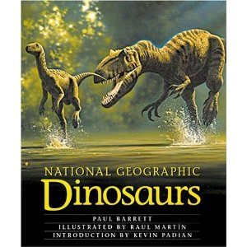
I really enjoyed this book on dinosaurs. Firstly, the amount of information (text) compared to pictures was just right. Secondly, the headings were colourful and these helped me to find the information which I wanted.
The illustrations were brilliant – the dinosaurs looked so lifelike!
On the other hand, there wasn’t a glossary in it. This would have been helpful as there were some technical words which I didn’t understand.

Slide 15
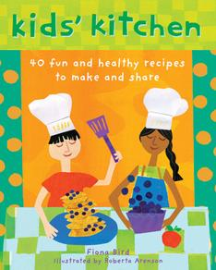
What I enjoyed about this book was that it was easy to find what you wanted. The contents pages split the recipes up into cakes, biscuits and main meals. Also, the photographs of the food helped me to picture what the food should look like if I got it right!
On the other hand, the recipes were a bit complicated. They should have used numbers or bullet points so that I could follow the order of the instructions.

Slide 16
Your turn: select a non-fiction book and look through it. Can you find any or all of these features?
A non-fiction book may have:
A contents page
An index
A glossary
Headings and sub-headings
Diagrams and pictures
Bullet points
Captions
Websites
Once you have browsed through the book, discuss it with your partner. Try to use some of the conjunctions from the examples to link your ideas.

Slide 17
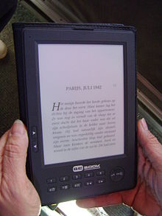

Paper or electronic?
Discussion
Most books are now available on electronic devices. What are the advantages and disadvantages of paper books and electronic ones?

Slide 18
So, when we are discussing books and texts which we have read, it is important to give our opinions and back them up.
Discussing fiction
Back up your opinion by referring to:
The plot.
The characters.
The settings.
How the author engaged you.
Discussing non- fiction
Back up your opinion by referring to features such as:
Contents, index and glossary.
The balance of text and pictures.
How interesting the information is.
How easy it is to find the information.

