Slide 1


M4a: Can solve problems choosing an appropriate mental or written strategy
Commissioned by The PiXL Club Ltd.
July 2018
This resource is strictly for the use of member schools for as long as they remain members of The PiXL Club. It may not be copied, sold nor transferred to a third party or used by the school after membership ceases. Until such time it may be freely used within the member school.
All opinions and contributions are those of the authors. The contents of this resource are not connected with nor endorsed by any other company, organisation or institution.
PiXL Club Ltd endeavour to trace and contact copyright owners. If there are any inadvertent omissions or errors in the acknowledgements or usage, this is unintended and PiXL will remedy these on written notification.
© Copyright The PiXL Club Limited, 2018

Slide 2
Vocabulary:
Problem Solving
strategy
inverse
number sentence
calculate
Teacher’s Note:
See ‘Vocabulary Shorts’ resource below for ideas and games to develop and embed vocabulary.
Vocabulary Shorts
Notes:
To locate Vocabulary Shorts resource click on:
Currency
Whole School Materials
English
Writing
PiXL Vocabulary
Vocabulary Shorts PP

Slide 3
Mathematical Strategies
Can solve problems choosing an appropriate mental or written strategy
In mathematics, it is really important to be able to solve problems correctly and efficiently. When you read a problem, you first need to try to work out what the problem is asking you to do (what calculation or operations you need to use) but also what the best strategy is. Sometimes a mental strategy is the most appropriate and sometimes a written strategy is more appropriate.

Slide 4
Mathematical Strategies
Can solve problems choosing an appropriate mental or written strategy
Can I do this in my head or do I need to write it down? What is the best strategy for this question?
Let’s look at some problems.
For each one, think:

Slide 5

Problem 1
Can solve problems choosing an appropriate mental or written strategy
There are 37 rows of chairs. There are 28 chairs in each row. How many chairs are there altogether?
Can I do this in my head or do I need to write it down? What is the best strategy for this question?
Notes:
Prompt pupils that we could use estimation first, followed by a written strategy to complete the calculation accurately.

Slide 6
Can solve problems choosing an appropriate mental or written strategy
This problem involves multiplication. To solve the problem, we need to work out the answer to: 37 x 28
There are 37 rows of chairs. There are 28 chairs in each row. How many chairs are there altogether?
Before we do this calculation, it is sensible to estimate what the answer will be.
37 can be rounded up to 40
28 can be rounded up to 30
A sensible answer to this calculation would therefore be:
40 x 30 = 1,200

Slide 7
Can solve problems choosing an appropriate mental or written strategy
Now, let’s work out the actual answer.
One strategy to use to solve this problem would be the grid method…
There are 37 rows of chairs. There are 28 chairs in each row. How many chairs are there altogether?

Slide 8
Grid method
Can solve problems choosing an appropriate mental or written strategy
6 0 0
1 4 0
2 4 0
+ 5 6
1 0 3 6
There are 37 rows of chairs. There are 28 chairs in each row. How many chairs are there altogether?
X | 30 | 7
20 | 600 | 140
8 | 240 | 56
Therefore, the total number of chairs will be 1,036.
1

Slide 9

Your turn
Can solve problems choosing an appropriate mental or written strategy
A bookcase has 13 shelves. Each shelf can hold 27 books. How many books can the bookcase hold?
Can I do this in my head or do I need to write it down? What is the best strategy for this question?

Slide 10
Problem 2
Can solve problems choosing an appropriate mental or written strategy
Caris has a table which is 84 cm high. She puts a table lamp on top. The lamp is 48 cm tall. How high is the top of the lamp from the floor?
Can I do this in my head or do I need to write it down? What is the best strategy for this question?
Notes:
Prompt pupils that we could a mental strategy for this question (such as rounding and adjusting)

Slide 11
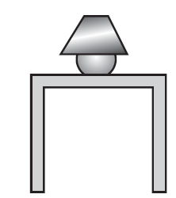
Can solve problems choosing an appropriate mental or written strategy
To answer this question, we need to add the height of the table to the height of the lamp. We therefore need to do the following calculation:
84 + 48
Caris has a table which is 84 cm high. She puts a table lamp on top. The lamp is 48 cm tall. How high is the top of the lamp from the floor?

Slide 12
Can solve problems choosing an appropriate mental or written strategy
This is a calculation which could be done in our head. There are several mental strategies we could use but because one of the numbers is close to a multiple of 10, we will use rounding and adjusting.
Caris has a table which is 84 cm high. She puts a table lamp on top. The lamp is 48 cm tall. How high is the top of the lamp from the floor?

Slide 13
Rounding and adjusting
Can solve problems choosing an appropriate mental or written strategy
Let’s first round 48 to 50. We can then work out:
84 + 50 = 134
However, by adding 50 to 84, we have added 2 too many. We therefore need to take 2 away from 134 making 132.
So, 84cm + 48cm = 132cm
Caris has a table which is 84 cm high. She puts a table lamp on top. The lamp is 48 cm tall. How high is the top of the lamp from the floor?

Slide 14
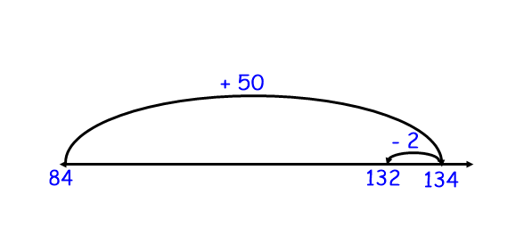
Rounding and adjusting
Can solve problems choosing an appropriate mental or written strategy
The number line below illustrates this strategy:
Caris has a table which is 84 cm high. She puts a table lamp on top. The lamp is 48 cm tall. How high is the top of the lamp from the floor?

Slide 15
Your turn
Can solve problems choosing an appropriate mental or written strategy
Can I do this in my head or do I need to write it down? What is the best strategy for this question?
There are 88 children from Key Stage 2 going on the school trip and 64 from Key Stage 1. How many are going altogether?

Slide 16
Problem 3
Can solve problems choosing an appropriate mental or written strategy
12,500 people visited the museum this year. This is 2568 more than last year. How many people visited the museum last year?
Can I do this in my head or do I need to write it down? What is the best strategy for this question?
Notes:
Prompt pupils that as the numbers are so large, it is likely that we will need to use a written strategy.

Slide 17
Can solve problems choosing an appropriate mental or written strategy
Our first step in solving this problem is to work out what the problem is asking us to do – what calculation is needed? If 12,500 people visited the museum this year, which is 2568 more than last year, we need do a subtraction to work out how many people visited last year.
12,500 people visited the museum this year. This is 2568 more than last year. How many people visited the museum last year?
The calculation we need to do is:
12,500 – 2568
Notes:
If pupils are struggling to work out the calculation needed, the following hint could be helpful:
Sometimes in problems, it is easy to be confused by big numbers. We can make the problem easier to understand by replacing the numbers with simple numbers.
E.g. 5 people visited the museum this year. This is 3 more than last year. How many people visited the museum last year?
It should now be simpler to work out what calculation is needed.

Slide 18
Can solve problems choosing an appropriate mental or written strategy
The calculation we need to do is:
12,500 – 2568
12,500 people visited the museum this year. This is 2,568 more than last year. How many people visited the museum last year?
The numbers in this calculation are a bit too large to work out in our head. We therefore need to use an efficient written method. We will use the counting on method, but you may be happy using a different method!
Notes:
Discuss alternative written methods for subtraction.

Slide 19
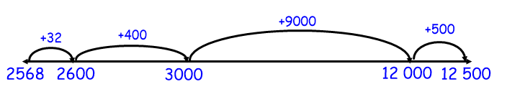
Counting on method
Can solve problems choosing an appropriate mental or written strategy
The calculation we need to do is:
12,500 – 2,568
We can do this by finding the difference between the two numbers by counting on.
We now need to add the steps together:
32 + 400 + 9,000 + 500 = 9,932
So 12,500 – 2,568 = 9,932

Slide 20
Your turn
Can solve problems choosing an appropriate mental or written strategy
Can I do this in my head or do I need to write it down? What is the best strategy for this question?
5,639 people attended a football match. The previous week 7,564 people attended. What is the difference in attendance figures?

Slide 21
Problem 4
Can solve problems choosing an appropriate mental or written strategy
There are 12 eggs in a box. How many boxes will 192 eggs fill?
Can I do this in my head or do I need to write it down? What is the best strategy for this question?
Notes:
Prompt pupils that this is a division problem and a written strategy will be efficient.

Slide 22
Can solve problems choosing an appropriate mental or written strategy
This problem requires us to work out how many 12s are in 192. It therefore is a division problem. The calculation we need to complete is:
192 ÷ 12
An efficient strategy to work out this calculation would be chunking…
There are 12 eggs in a box. How many boxes will 192 eggs fill?
Notes:
Discuss alternative written methods for division.

Slide 23
Chunking
Can solve problems choosing an appropriate mental or written strategy
We have taken 10 groups of 12 and 6 groups of 12 away from our total.
10 + 6 = 16
So, 192 ÷ 12 = 16
Answer: 16 boxes
192 ÷ 12
There are 12 eggs in a box. How many boxes will 192 eggs fill?
1 9 2
- 1 2 0
7 2
7 2
0
(10 X 12)
(6 X 12)

Slide 24
Your turn
Can solve problems choosing an appropriate mental or written strategy
A netball team is made up of 7 players. If 212 children turn up to a netball tournament, how many full teams can you make?
Can I do this in my head or do I need to write it down? What is the best strategy for this question?

Slide 25
Choose an appropriate strategy to solve these problem:
Can solve problems choosing an appropriate mental or written strategy
24 children each pay £14.65 towards a school trip. How much money is collected?
It is 329km from Leeds to Norwich. Jason travels 186km and then takes a break. How many more km does he need to travel before he reaches his destination?
16 children share 144 sweets equally between them. How many do they have each?

Slide 26
Can solve problems choosing an appropriate mental or written strategy
Links:
Number – addition and subtraction (mental and written)
Number – multiplication and division (mental and written)

