Slide 1



Language as a suggestion
When we consider how language ‘suggests’ an idea to the reader, it is important to understand the difference between explicit information and implicit information.
Explicit information is something that is directly told to the reader. It can’t be argued with or misinterpreted – it is clearly stated in the text. For example:
The swimmer was tired as he got out of the water.
We categorically know that the swimmer is tired.
Implicit information is something that is suggested to the reader, but could be interpreted differently by different readers. For example:
The swimmer panted and stumbled as he got out of the water.
We could guess from the use of ‘panted and stumbled’ that the swimmer is tired.

Slide 2

Associated meanings
It is sometimes useful to consider other words or ideas that we would associate with specific language. This helps us to build up a picture in our minds.
‘…like a ballerina, gracefully pirouetting on her pointed toes…’
Your turn
‘…his eyes flashed with the ferocity of a thousand thunderstorms…’
Suggests that…
Something is turning on a point
It is beautiful, elegant, fragile
The subject is gentle
The movement is controlled and positive
‘…its warped, gnarly trunk stood obstinately amidst the young saplings…’

Slide 3
What do we definitely know?
When you are asked to identify what language suggests about something, it is important to identify what you definitely know already. The explicit information can be clearly identified within the text. Some people like to underline or highlight this.
Read this passage. Write down everything that you definitely know and be prepared to explain how you know it.
Alice shivered, wrapped her dressing gown tightly around her and braved the short journey from her bed to the window. Outside, the heavily-frosted grounds were glistening in the weak, early morning sunshine. A faint smile twitched at the corners of her mouth. It looked like today would be the day: the grand finale of a drama that had begun nine months ago …

Slide 4
What can we guess?
Once you have identified what you already know (the explicit information), you can move on to the detective work. Look closely at the language, what does each underlined phrase or word suggest to you as the reader? Can you explain why?
Alice shivered, wrapped her dressing gown tightly around her and braved the short journey from her bed to the window. Outside, the heavily-frosted grounds were glistening in the weak, early morning sunshine. A faint smile twitched at the corners of her mouth. It looked like today would be the day: the grand finale of a drama that had begun nine months ago…
Look on the next page to compare your answers.

Slide 5
What can we guess?
Alice shivered,
Suggestion: Alice was cold or frightened.
Suggestion: Alice didn’t really want to move from her bed to the window. Her room was small and it didn’t take long to get to the window.
braved the short journey
Suggestion: Although it was early, it looked like it was going to be a nice day. The sky was clear. Perhaps it was coming into spring time.
weak, early morning sunshine.
Suggestion: Alice was beginning to feel happy, although she didn’t want other people to see it. Perhaps she hadn’t been feeling happy before this point in the story.
faint smile twitched

Slide 6
What does the language suggest?
Your turn
Brainstorm as many ideas as you can for each example.
Her frustration grew stronger. It was happening again. She felt truly helpless.
The flames danced gleefully in her eyes. She looked just like another innocent bystander.
Without a sound, he crept down the rickety staircase. The last thing he needed was to get caught.
They looked just like tiny ants, scurrying around in a vast ant colony.

Slide 7


Teacher Guidance
Having worked on the Think It questions, the expectation is the pupil completes the first A2 therapy test (separate to this resource).
Additional PiXL resources designed to demonstrate a deeper understanding within subjects are:
The PiXL Progression Ladders
The PiXL Knowledge Mats – Think It

Slide 8
With a slight jolt, his mind returned to the here and now. How long had he been gazing out of the window? He had no idea. He just knew he had to try to stay focused.
What does this extract suggest about the character? Click to check.
He could be bored, tired or perhaps worried about something.

Slide 9
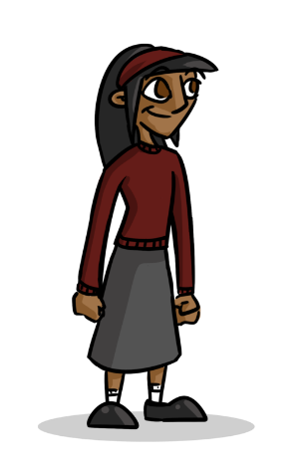
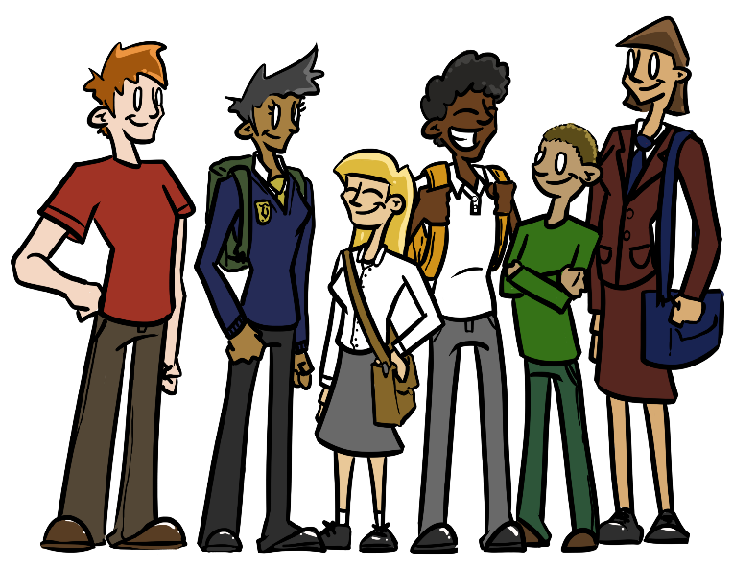
Jacinta and Scott are arguing about what this sentence suggests about the character: He noticed that her face had suddenly flushed a deep red. Who is right? Click to check.
She is clearly embarrassed because she is blushing.
I disagree. I think she is angry.
Jacinta
Scott
Both of them could be right. The problem is that there is not enough context for either of them to be sure.

Slide 10
Your turn
The events of that morning had left me decidedly perturbed and I resolved to do whatever it took to put my mind at ease.
Based on this extract, offer two possible synonyms for each of the words below. Click for our suggestions.
perturbed _______________ ________________
resolved _______________ ________________
Your turn.
The events of that morning had left me decidedly perturbed and I resolved to do whatever it took to put my mind at ease.
Based on this extract, offer two possible synonyms for each of the words below. Click for our suggestions.
perturbed worried, troubled, disconcerted, uneasy
resolved decided, undertook, made up my mind

Slide 11
Your turn
Initially, Ty was elated to receive the invitation but soon he was in a cold sweat. How would he get there? How would he get back? Would he fit in?
What does this extract suggest about Ty’s feelings on receiving the invitation.
He was very pleased at first but then he got nervous. This suggests that he is an anxious person.
Offer two possible synonyms for the word elated.
thrilled, delighted, overjoyed, ecstatic
Your turn
Initially, Ty was elated to receive the invitation but soon he was in a cold sweat. How would he get there? How would he get back? Would he fit in?
What does this extract suggest about Ty’s feelings on receiving the invitation.
Offer two possible synonyms for the word elated.

